Slide 1



HEO Novice Programming 2019-2020

Slide 2
Tom Renney
Tom Renney discussing the transition from Full Ice to Half Ice for Novice
https://www.youtube.com/watch?v=qFxET2726CY

Slide 3
Hockey Canada Mandate:
To accept the recommendation that the Novice age group shall only use half ice for all game play effective the 2019-20 season.
Mandate Carried

Slide 4
TOP 5 REASONS . . . KIDS PLAY SPORT
To have fun
To do something they’re good at
To improve their skills
To stay in shape
To get exercise
Institute for the Study of Youth Sports, Michigan State University (1989)

Slide 5
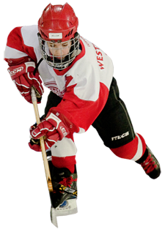
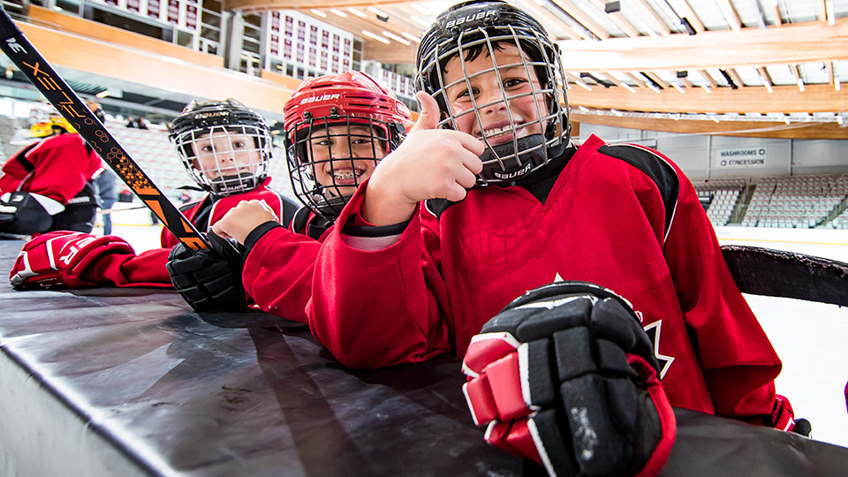
Why Novice Half Ice?
The program serves as the gateway to all hockey skills!

Slide 6
An innovative program approach . . .
FUNdamental sports skills:
Age appropriate skills programming
FUNdamental hockey skills:
Basic overall game skills
Skills in combination over time
"Learning the basic skills at a young age will set the foundation for everything a player will accomplish in the game of hockey.” Corey McNabb, Hockey Canada Director, Hockey Development Pro

Slide 7
The difference . . .
Half-ice hockey
Cross-ice hockey

Slide 8
No limitations on how to use ice . . .
Half-ice hockey:
2 games
1 game and a skills area
Half-ice hockey

Slide 9
Difference from IP to Novice?
Difference between Cross Ice and Half Ice:
Cross Ice (IP): Played in a smaller surface
Played with Smaller nets
Played with Blue pucks
Half Ice (Novice):
Played on larger ice surface than IP
Regulation sized nets
Regulation (Black) puck

Slide 10
Why change to Half Ice?
“Scaling down is important and the research shows that when children are more actively engaged, they touch the puck more often, have the puck on their stick longer, and are interacting with one another to a greater extent.” Dr. Stephen Norris, Consultant to Hockey Canada
“You have to be able to make plays in pretty small areas. The more you practice in small spaces the better off you are.” Sidney Crosby, Canada’s National Men’s Team

Slide 11

Body Contact and Puck Battles
2 X Greater
Full Ice
Cross Ice

Slide 12
Shots Per Player
6 X Greater
Full Ice
Cross Ice

Slide 13
Individual Player Puck Touches
2 X More
Full Ice
Cross Ice

Slide 14
Shots on Goal Every Minute
1.75 shots
.45 shots
Full Ice
Cross Ice

Slide 15
Pass Attempts
2 X Greater
Full Ice
Cross Ice

Slide 16
Pass Receptions
5 X Greater
Full Ice
Cross Ice
All stats courtesy of USA Hockey 2014

Slide 17
A Grassroots-up Approach
There is resistance to change within the hockey culture. Who needs to hear the message?
Families (Players and Parents)
Coaches
Minor Hockey Associations
Leagues
Notes:
Parents are the GATEKEEPERS

Slide 18
Frequently Asked Questions
What is the the key driver for the shift to the new Novice format?
Hockey Canada developed the program to ensure that a child’s early experiences with hockey are delivered in a safe and positive experience. The program enables participants to become contributing members of a team effort, develop self-confidence and experience a sense of personal achievement. The goals of the program are:
To have fun while playing hockey and engaging in physical activity.
To learn the fundamental skills required to play the game of hockey.
To develop and refine basic motor patterns.
To be introduced to the concepts of cooperation and fair play.

Slide 19
Frequently Asked Questions
Get small kids off full size adult rinks and into an age/size appropriate game playing area
Get kids more engaged in game play, provide more enjoyment for kids in the games and less boredom
Increase skill development in games by decreasing space and increasing the puck touches and skill executions
Provide a more logical progression from cross ice game play at IP

Slide 20
Frequently Asked Questions
Who is developing the changes to the Novice program?
Hockey Canada has established a “Task Team” made up of representatives from all of the branches across Canada including HEO. This Task Team has been meeting for several months and is developing a set of consistent policies and standards for implementation in 2019-2020.

Slide 21
Frequently Asked Questions
How can we be sure that the Hockey Canada policies will accurately represent issues relevant to Hockey Eastern Ontario?
HEO has a representative on the Hockey Canada Task Team. In addition, as part of the HEO Development Committee, a HEO/HEO Minor Novice Sub-Committee has been struck. There are representatives from Districts and Associations within the branch to reflect our local issues and concerns.

Slide 22
Frequently Asked Questions
Will the half-ice program be mandatory?
Yes.
However, it is understood that there is a wide variety of half-ice delivery options to accommodate different local conditions so as the policies are developed, they will designed with some degree of flexibility so those local conditions can be accommodated.

Slide 23
Frequently Asked Questions
WiIl the new Novice program be open to IP players?
No.
No players under 7 years of age will be permitted to play in the Novice program.

Slide 24
Frequently Asked Questions
Will there still be “tiering”?
It is still anticipated that there will be tiering (where registrant levels permit) to reflect the difference in skill levels.
It’s possible that there could be changes to the existing tiering models or the number of tiers as the teams continue their work.

Slide 25
Frequently Asked Questions
What will happen to the Novice competitive programs?
Hockey Canada has not taken a position on competitive hockey only that all Novice programs must be delivered in half ice format.
As This will be discussed as part of the HEO Development sub-committee

Slide 26
Frequently Asked Questions
Will the number of players per team change?
This is one of the issues that will be reviewed by the HEO Development Sub-committee.

Slide 27
Frequently Asked Questions
Will the new program impact program costs or result in increases/decreases in registration costs?
Although the specifics of the program is still in development, it is not expected that this will have a material impacts of costs either up or down.

Slide 28
Questions
Any questions can be directed to
Jeff Robert
HEO’s Development Programs Officer
jrobert@hockeyeasternontatio.ca

